Slide 1

CSM Project- CI/CD Pipeline through Jenkins
Group members-
Annie jain
Asmi goel

Slide 2
CONTENT
Introduction
Problem Statement
Motivation
Objectives
Tech Stack
Methodology
SWOT Analysis
Application of the Projec
References

Slide 3
INTRODUCTION
Nowadays, conventional software development methods are insufficient for today’s business needs.
Adapting to agile practices can increase the flexibility, efficiency, and speed of the software development life cycle, which is what software development companies are attracted to.
For this reason, many researchers and companies try to develop their own solutions to building a product that can generate and automate the entire process of Continuous Integration (CI), Continuous Delivery (CD), and Continuous Deployment (CDT).
By the end of the project, we will have a working CI/CD pipeline that can be used to automate the process of building, testing, and deploying software applications on AWS using Jenkins.
This pipeline can be used as a starting point for developing more complex CI/CD pipelines or customized to meet specific requirements for your software development projects.

Slide 4
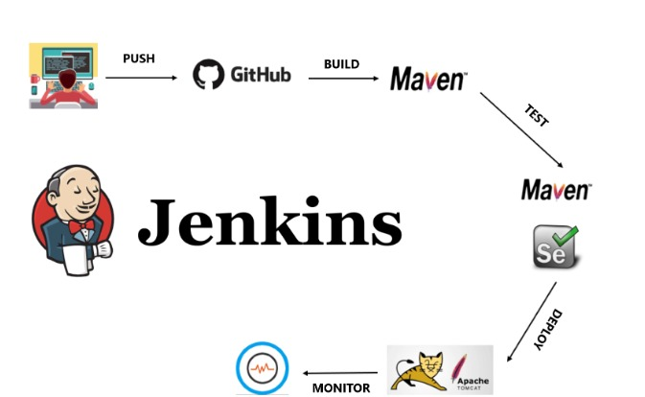
IMPLEMENTATION PROCESS

Slide 5
PROBLEM STATEMENT
The problem that a CI/CD pipeline through Jenkins solves is the manual and time-consuming process of building, testing, and deploying software applications.
In traditional software development, these tasks are typically done manually, which can result in errors, delays, and inconsistent results.
This automation allows developers to focus on writing code rather than on the manual processes involved in building and deploying software.

Slide 6

OBJECTIVE
Deploy end-to-end application using Jenkins CICD with GitHub Integration
Trigger Jenkins pipeline automatically once the code is pushed on GitHub
To identify the best practices for implementing and securing CI/CD pipelines, taking into account industry standards and regulations.
To develop a Jenkins-based CI/CD pipeline that incorporates the identified best practices and optimization strategies.

Slide 7
TECHNOLOGY STACK
Jenkins: Jenkins is an open-source automation server used for building, testing, and deploying software. It integrates with many tools and plugins and is highly configurable.
GitHub: GitHub is a web-based platform for version control and collaboration using Git. It provides hosting for software development and allows teams to collaborate on code and projects.
Docker: Docker is an open-source containerization platform that allows developers to package, deploy, and run applications in a self-contained environment.
AWS EC2 Instance- EC2 allows users to easily create and manage virtual servers, known as EC2 instances, in the cloud.

Slide 8
METHODOLOGY
The methodology of a CI/CD pipeline through Jenkins involves several steps, including:
Version Control: Developers commit changes to the codebase in a version control system such as Git.
Build: Jenkins pulls the latest code from the version control system and compiles it into an executable package.
Test: Jenkins automatically runs a series of automated tests to ensure that the software application is working correctly. This includes unit tests, integration tests, and acceptance tests.
Deploy: Jenkins deploys the executable package to the target environment, such as a testing or production environment.
Monitor: Jenkins continuously monitors the deployed software application to ensure that it is functioning correctly. This includes checking for errors, performance issues, and security vulnerabilities.
Continuous Improvement: Based on the feedback received, developers make changes to the code and repeat the process, continuously improving the quality of the software application.
This methodology ensures that software applications are built, tested, and deployed in a consistent and automated manner, improving the speed, quality, and reliability of the software development process. Jenkins, as an automation tool, plays a crucial role in the implementation of this methodology, by automating the process of building, testing, and deploying software applications.

Slide 9
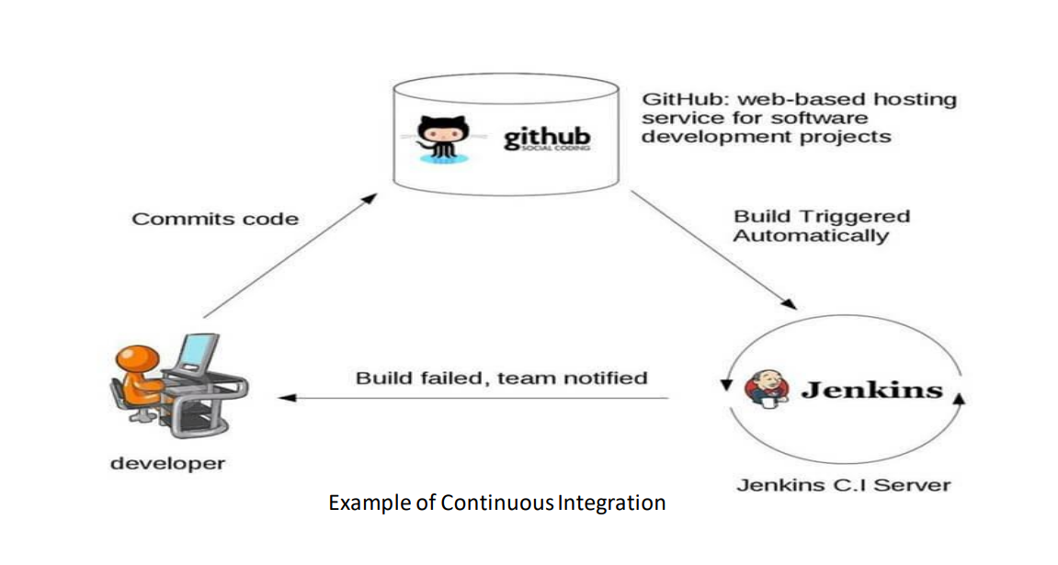

Slide 10
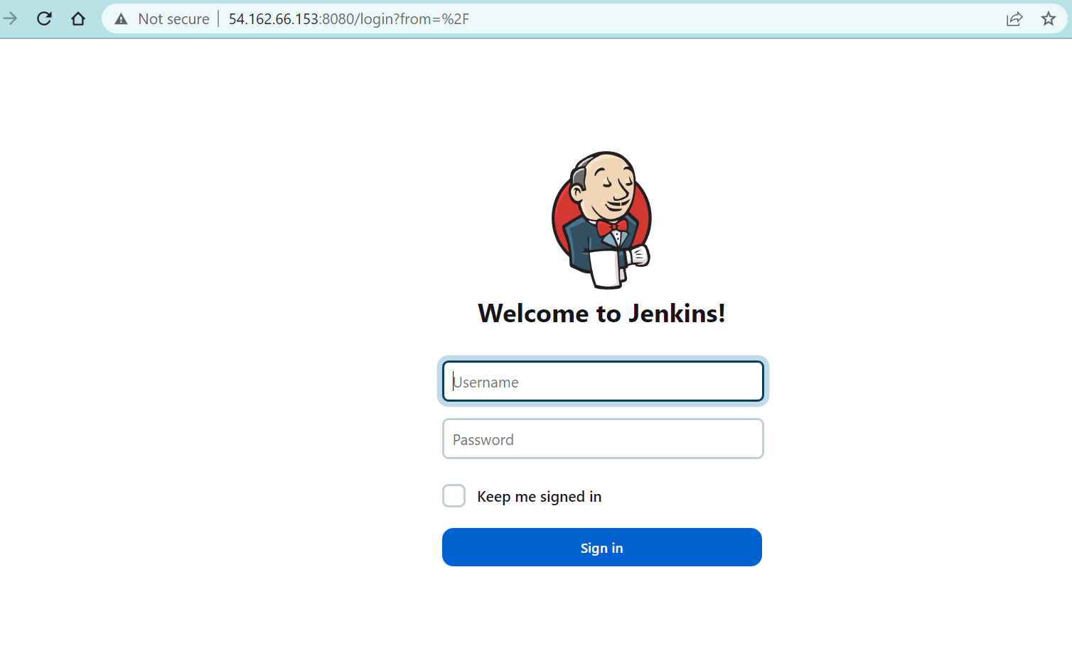

Slide 11
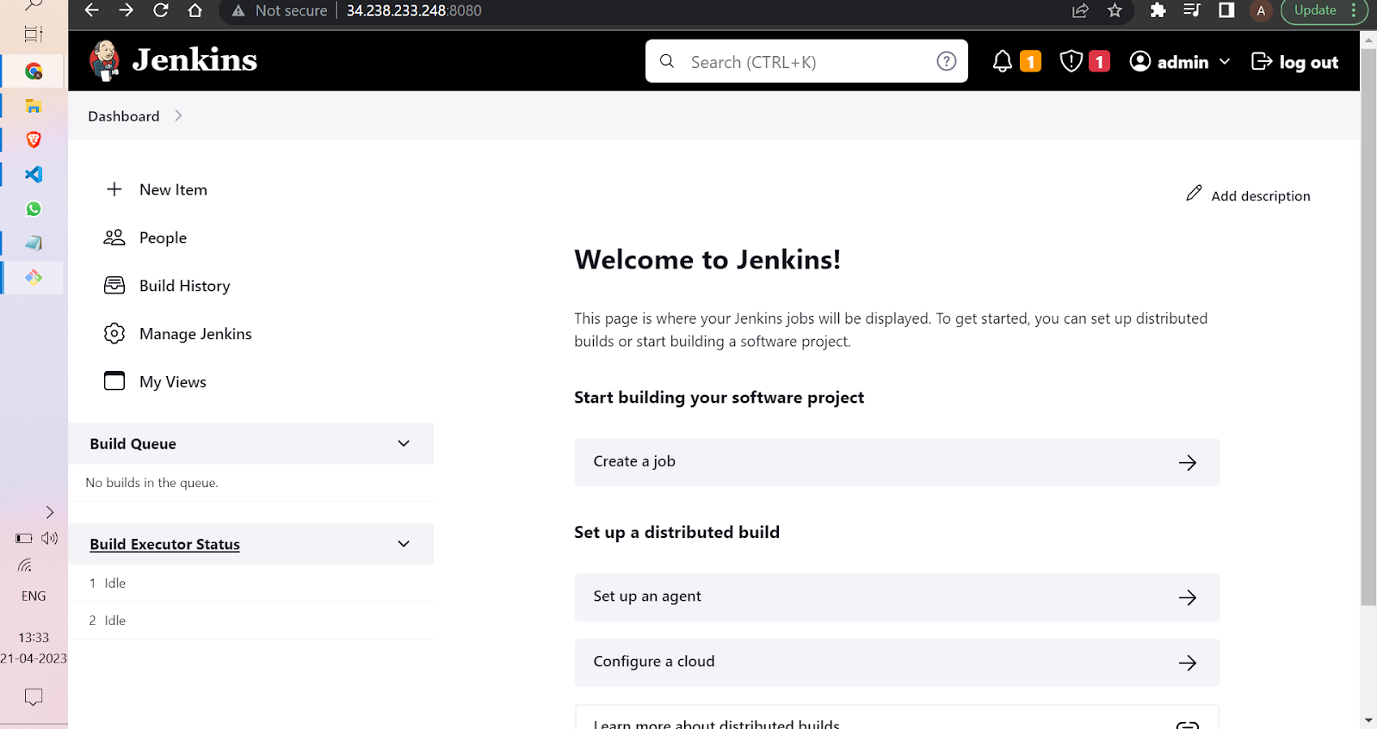

Slide 12
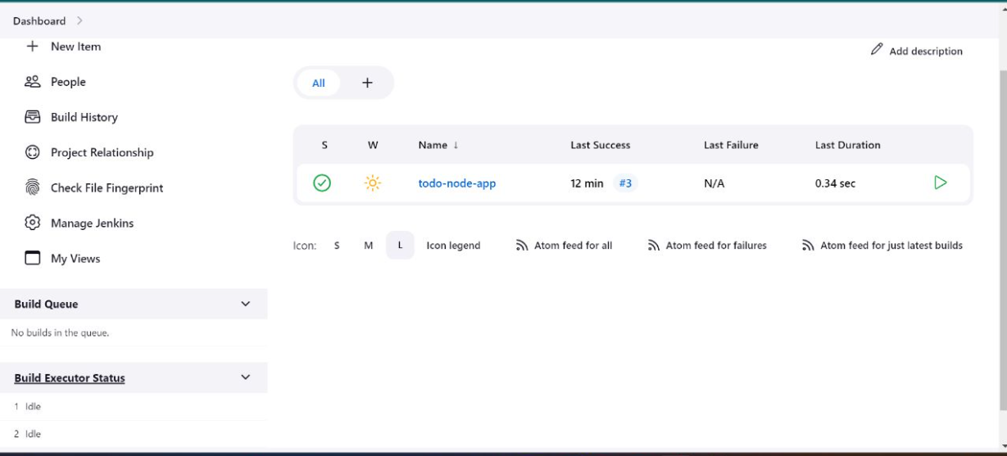

Slide 13
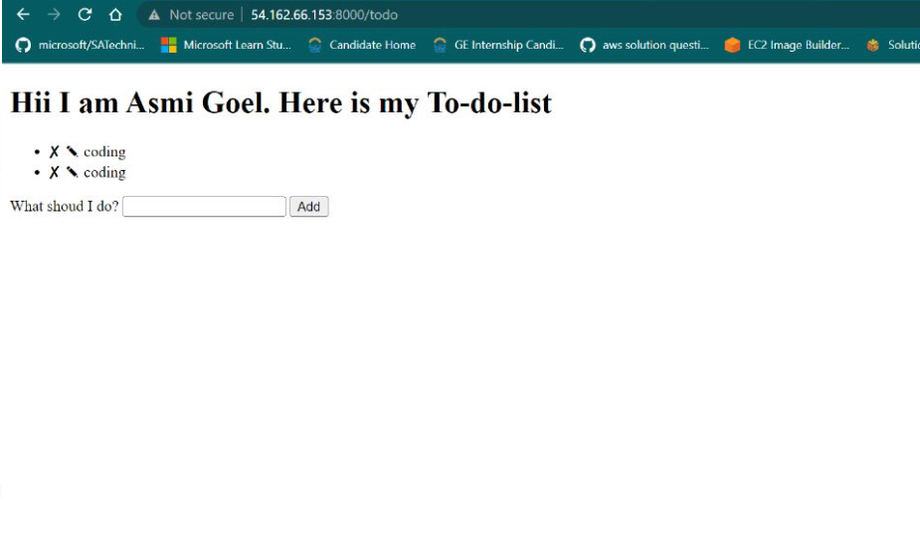
WEBSITE DEPLOYED ON PORT NO: 8080

Slide 14
SWOT ANALYSIS
Strengths:
Automation: Jenkins provides a powerful automation framework for building and deploying software, which can help reduce manual errors and improve the overall quality of software releases.
Flexibility: Jenkins offers a wide range of plugins and integrations, allowing for customization of the CI/CD pipeline to meet specific project requirements.
Integration with other tools: Jenkins can be integrated with other tools such as Git, and Docker, allowing for streamlined development and deployment workflows.
Weaknesses:
Maintenance: Maintaining a Jenkins server can be time-consuming and may require specialized skills and resources.
Security: Like any other software tool, Jenkins can be vulnerable to security threats if not configured leading to potential data breaches.
Opportunities:
Increased efficiency: A well-designed CI/CD pipeline through Jenkins can lead to faster software delivery, reduced lead times, and increased efficiency.
Continuous improvement: A CI/CD pipeline through Jenkins can help teams identify and address issues quickly, leading to continuous improvement in software quality and delivery.
Threats:
As technology advances, newer tools and frameworks may emerge, which could render Jenkins obsolete if it fails to keep up with the latest trends.

Slide 15
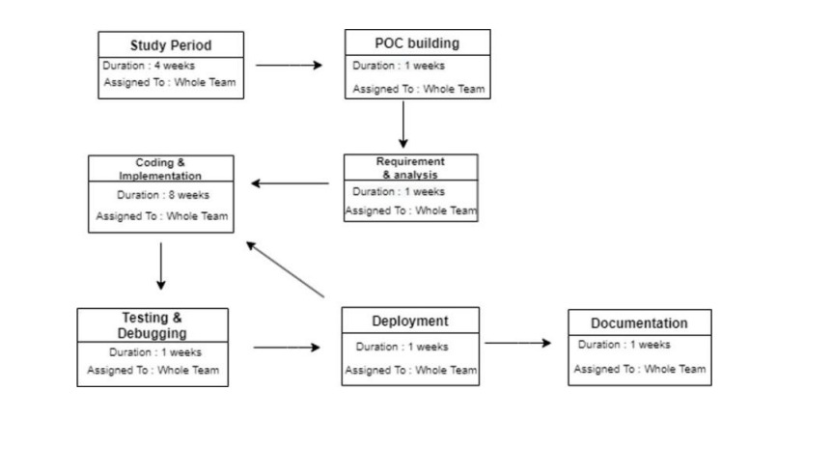
PERT CHART

Slide 16
APPLICATION OF THE PROJECT
Automated testing: Jenkins can automatically run unit, integration, and acceptance tests after every code change, which ensures that the code is working correctly and that new changes don't introduce new bugs.
Continuous Integration: Jenkins can continuously build, test, and validate code changes in a shared repository, helping to identify any issues early in the development process.
Continuous Deployment: Jenkins can automate the deployment process, allowing developers to quickly and easily deploy their code changes to production environments.
Code analysis: Jenkins can be used to automatically analyze code quality, security vulnerabilities, and coding standards compliance using various plugins and integrations.
Release management: Jenkins can be used to manage the release process, allowing for controlled releases to production environments, rollbacks, and monitoring of releases.
Containerization: Jenkins can be used to build and deploy containerized applications, allowing for easy scalability and portability of applications.
Infrastructure as code: Jenkins can be used to manage infrastructure as code, allowing developers to automatically provision and manage infrastructure resources required for application development and deployment.

Slide 17
REFERENCES
https://www.geeksforgeeks.org/what-is-ci-cd/
https://ieeexplore.ieee.org/document/7100245
https://www.semanticscholar.org/paper/A-Study-on-Development-Operations-for-Continuous/e75ad9c445e3668528e65f7da69878a711dbd953
https://jusst.org/wp-content/uploads/2021/06/A-review-on-Continuous-Integration-Delivery-and-Deployment-using-Jenkins.pdf
https://docs.gitlab.com/ee/ci/docker/using_kaniko.html
https://pages.awscloud.com/rs/112-TZM-766/images/A-Roadmap-to-Continuous-Delivery-Pipeline-Maturity-dev-whitepaper.pdf
https://www.javatpoint.com/devops-pipeline-and-methodology

Slide 18

Thank You

